Slide 1

LAB MANUAL of Subject ESSENTIAL SKILLS OF INFORMATION TECHNOLOGY Subject Code: 09CT0101
Student Name: Meet Butani
Enrollment No: 91900957044

Slide 2
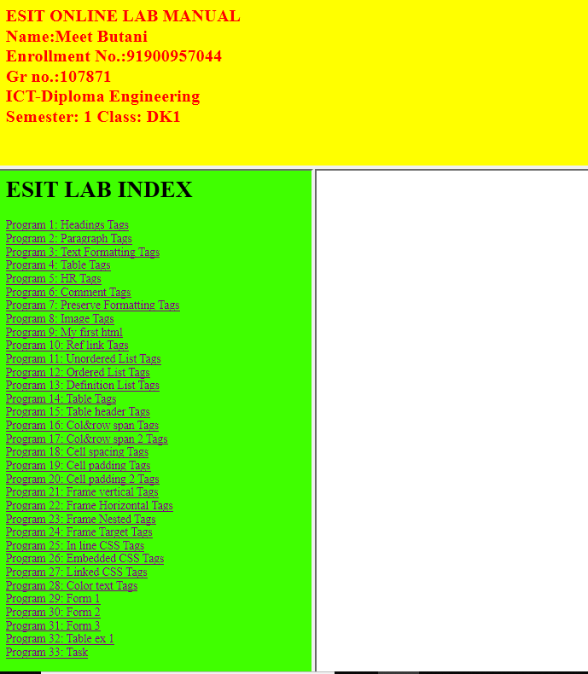
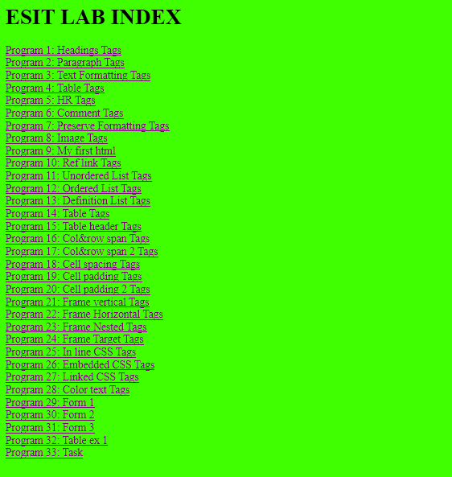
HTML PROGRAME
MainFrame.html
Navigation.html

Slide 3
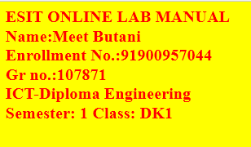
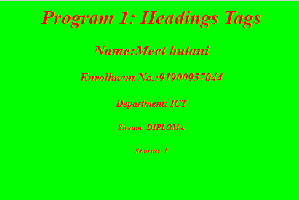
HTML PROGRAME
Header.html
Heading.html

Slide 4
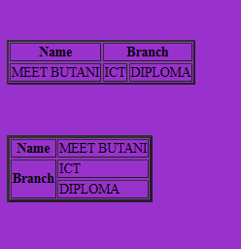

HTML PROGRAME
Colspan & Rowspan.html
Col&Rawframeset.html

Slide 5
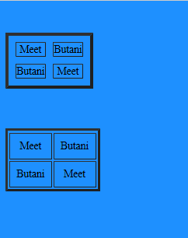
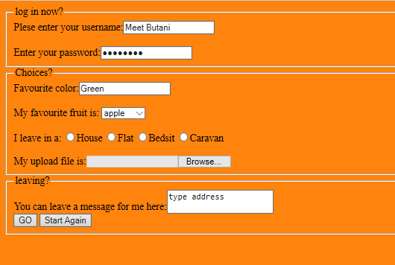
HTML PROGRAME
Cellspacing and Cellpadding.html
Form.html

Slide 6
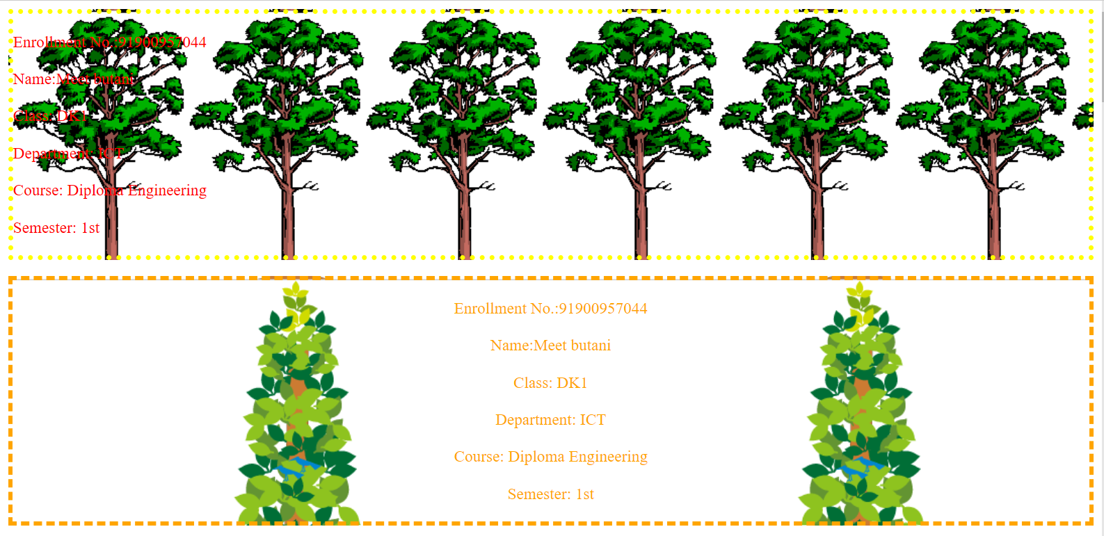
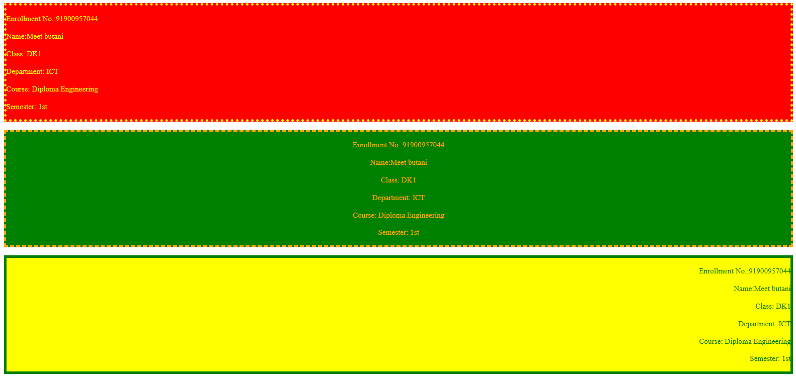
CSS PROGRAME
Background.html
Borders.html

Slide 7
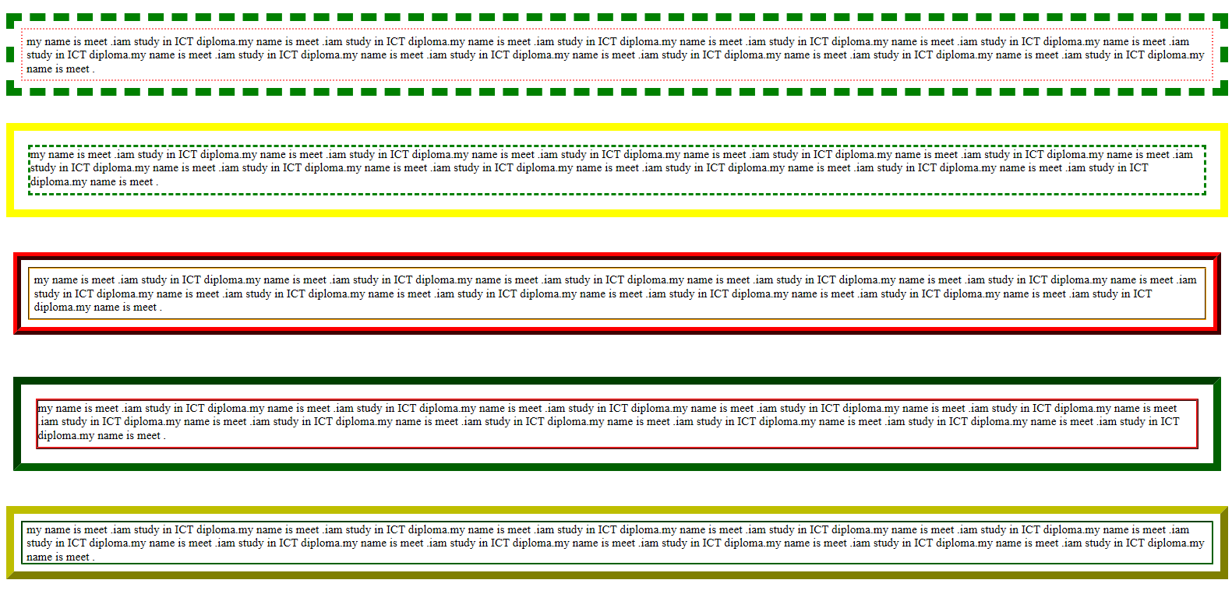
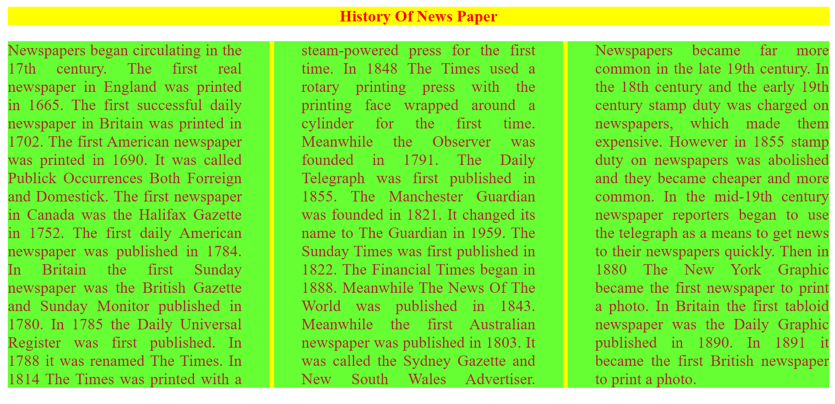
CSS PROGRAME
Boxmodal.html
Multipal Column.html

Slide 8
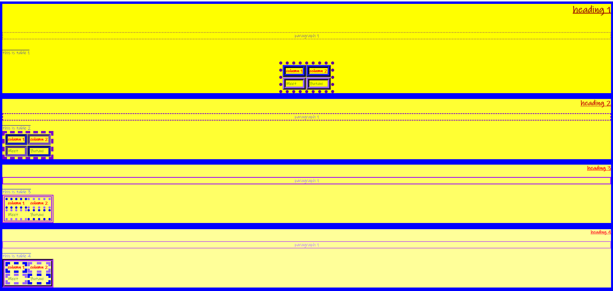
CSS PROGRAME
Selector.html

Slide 9
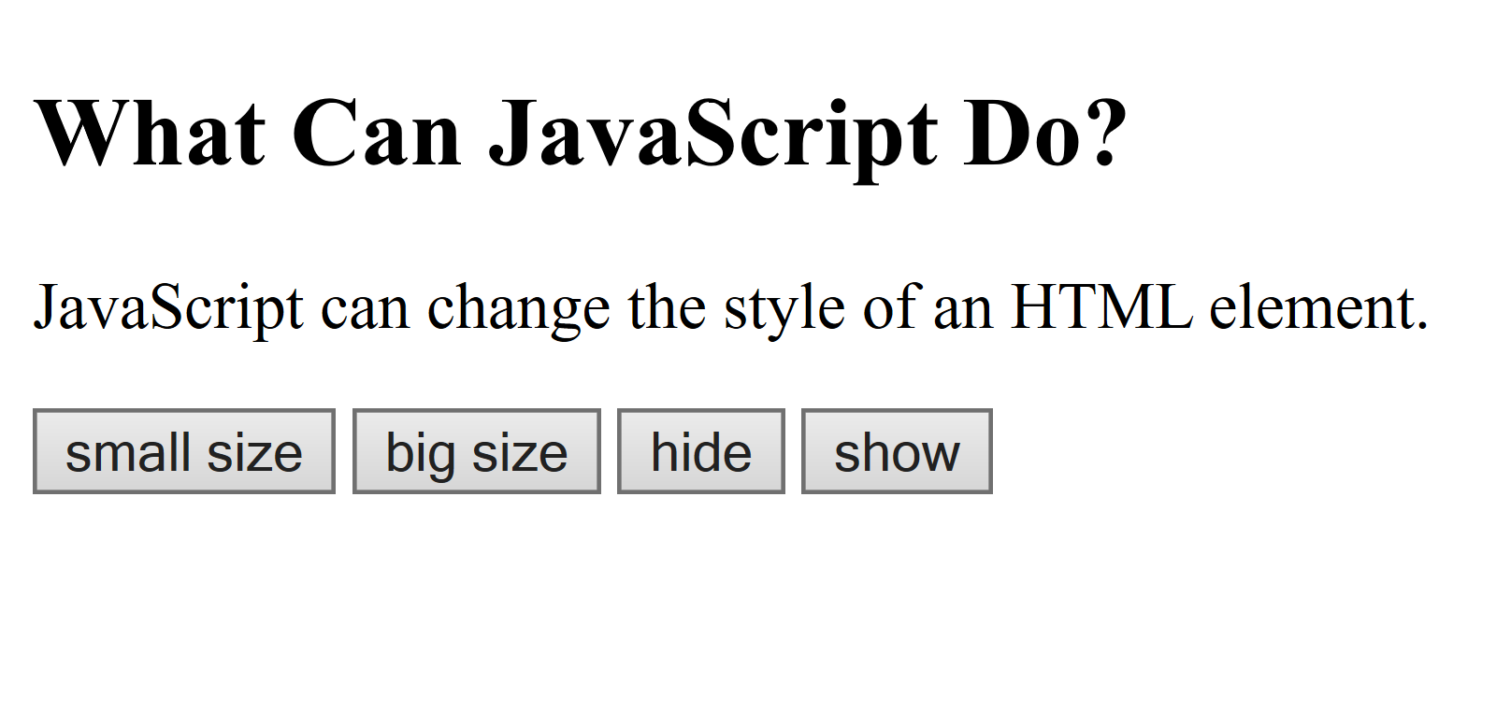
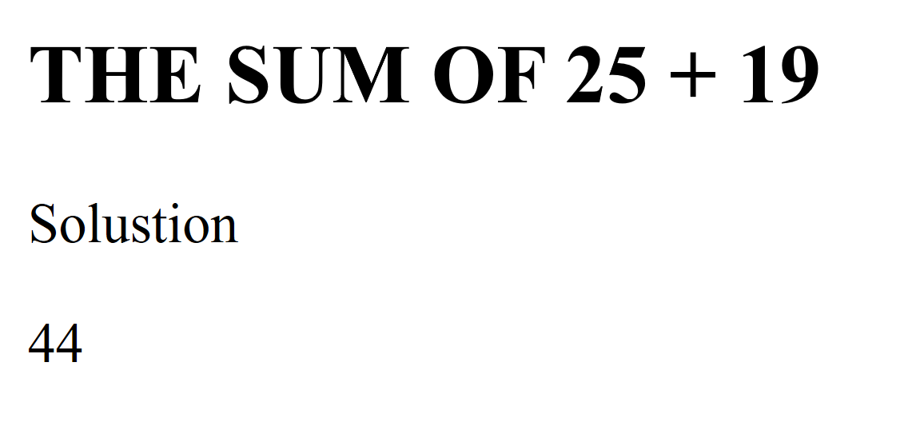
JAVASCRIPT PROGRAME
ChangeElement.html
TwoNoSum.html

Slide 10
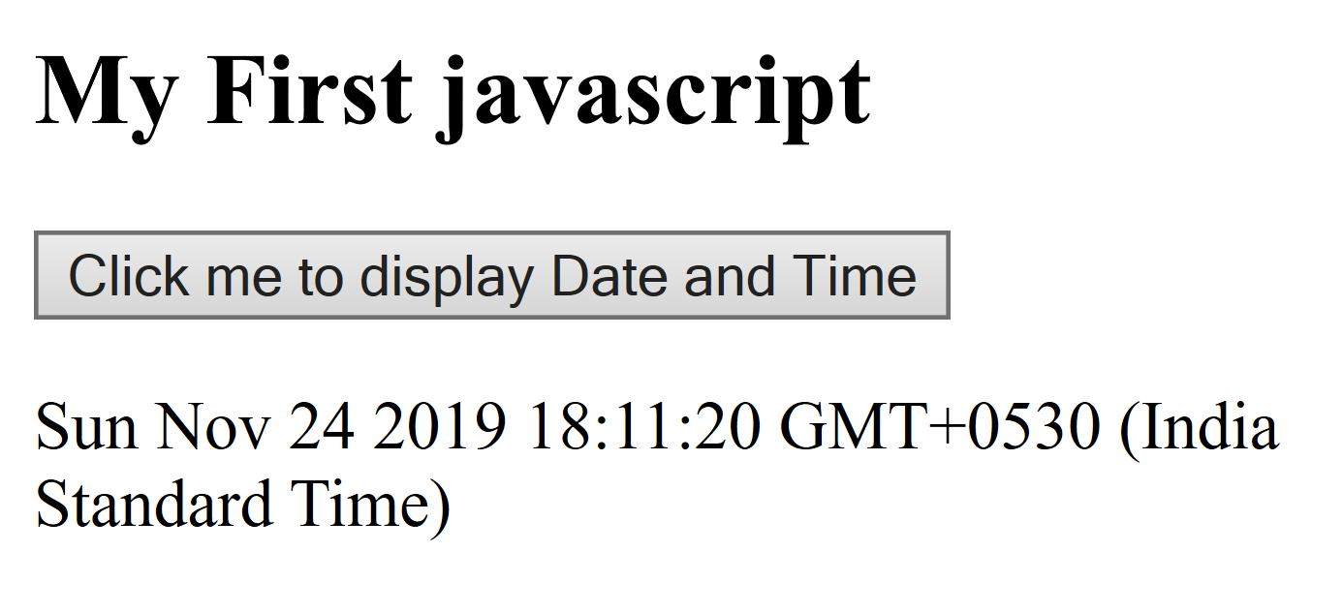
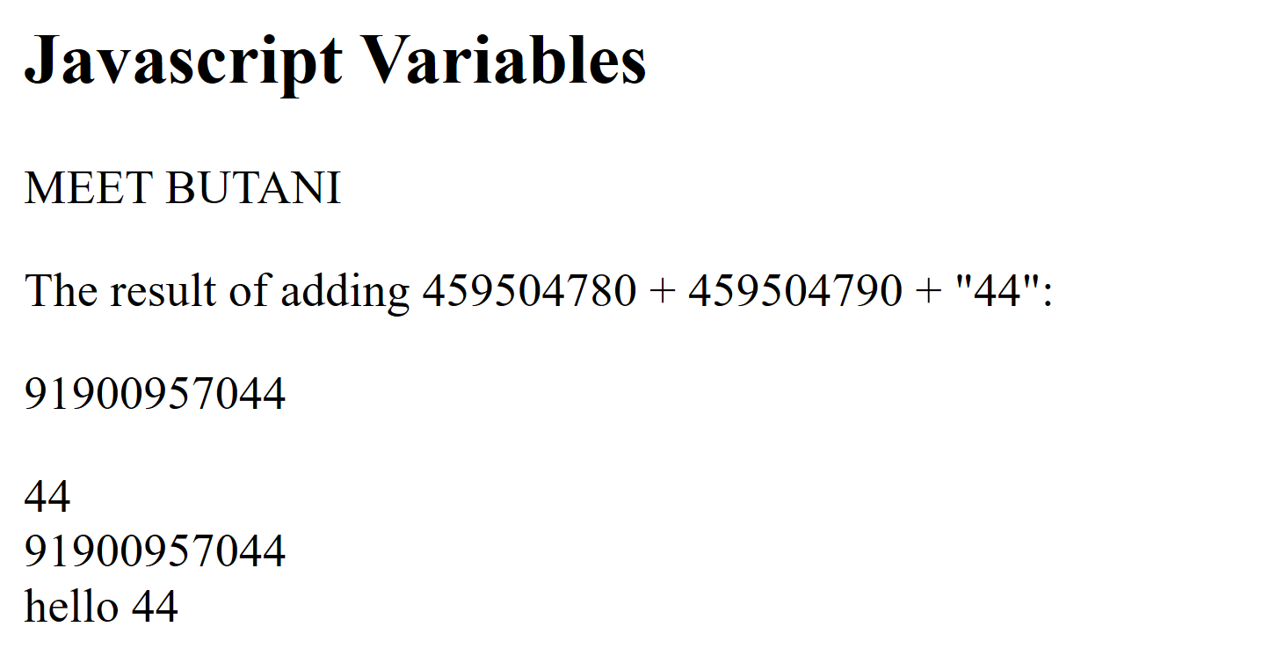
JAVASCRIPT PROGRAME
DisplayDateAndTime.html
Variables.html

Slide 11
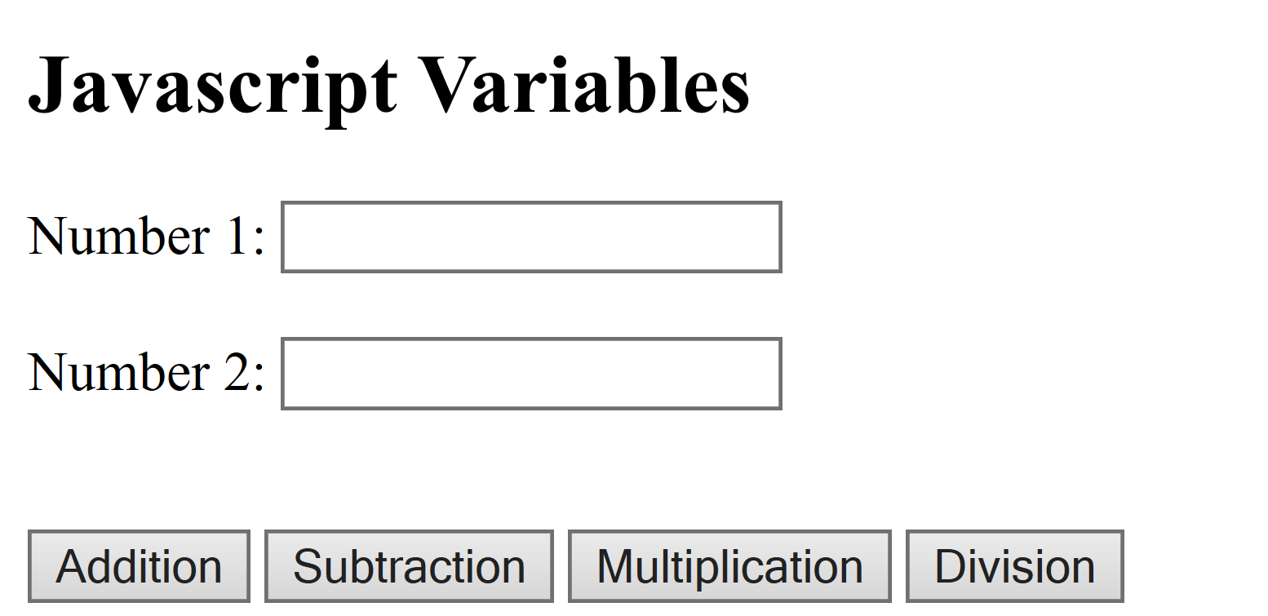
JAVASCRIPT PROGRAME
Calculator.html

Slide 12
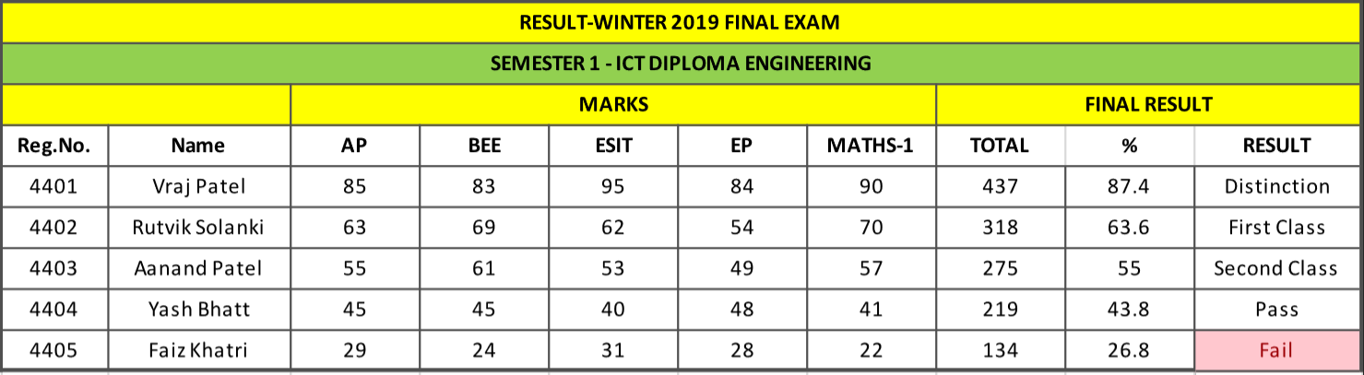
RESULT SPREADSHEET

Slide 13
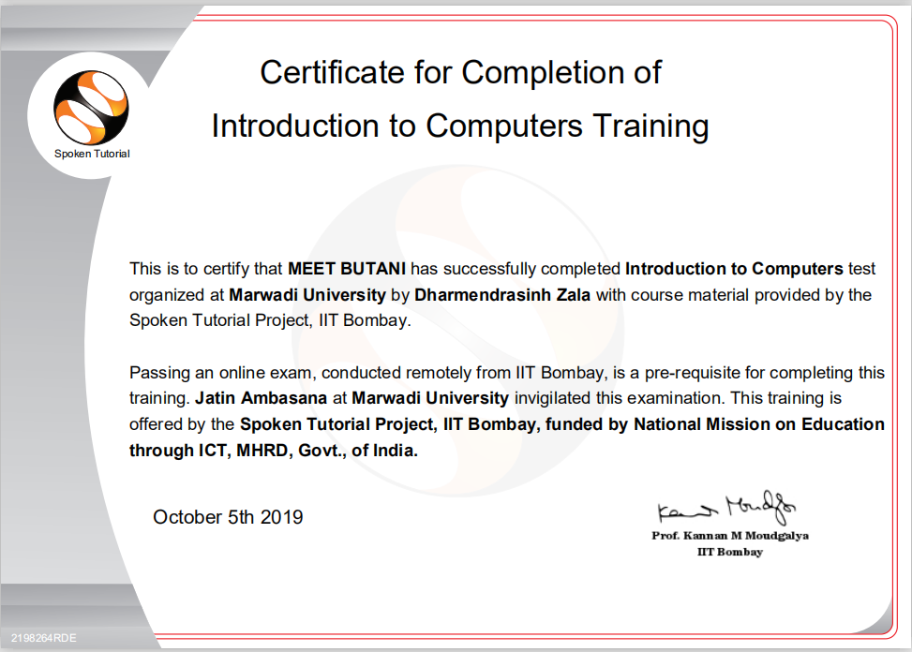
Spoken tutorial Certificate - Introduction to computer

Slide 14
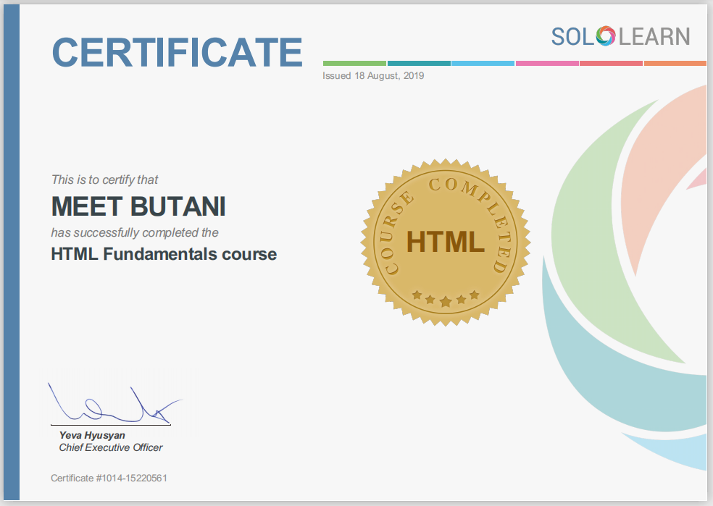
Solo Learn HTML Certificate

Slide 15
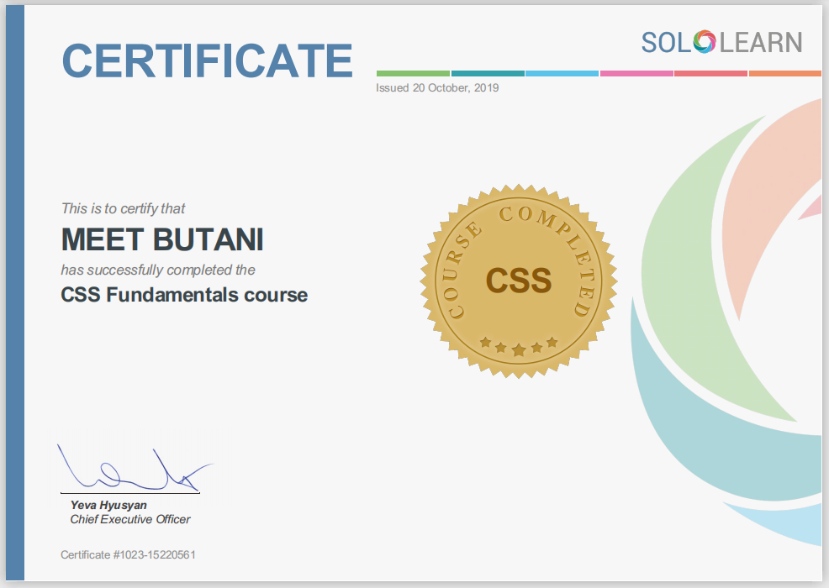
Solo Learn CSS Certificate

Slide 16

Solo Learn Java Script Certificate

